Slide 1
GENERATIVE AI · FINANCIAL RESEARCH AUTOMATION
Stock Picker Agent
An AI-powered multi-agent system for intelligent stock research and investment recommendations.
CREWAI + GROQ
MULTI-AGENT SYSTEMS

Slide 2
Scattered sources
Slow comparison
Information is scattered across sources.
Comparing companies takes time and careful judgment.
01 — THE PROBLEM
Stock research is fragmented, slow, and labor-intensive
Context overload
Manual reporting
News, fundamentals, and business context must be organized.
Structured research reports are costly to prepare manually.
The work is valuable, but the workflow is scattered.
Proposed solution: automate discovery, research, comparison, reporting, and delivery while keeping final decisions with a human.
Stock Picker Agent
2

Slide 3

02 — SYSTEM ARCHITECTURE
A delegated pipeline turns one request into a research report
User request → Manager Agent
Trending Company Finder Agent → Financial Researcher Agent
Python entry point · CrewAI delegation
Groq inference · Serper search
Stock Picker Agent → Research recommendation
PDF report generation → Email delivery
Comparison and reasoning
PDF generation tools · email integration
Stock Picker Agent
3

Slide 4





03 — AGENT SYSTEM
Four specialized agents divide the reasoning work
Manager Agent
Trending Company Finder
Coordinates the workflow and delegates tasks.
Discovers candidates and gathers initial web research.
Financial Researcher
Stock Picker
Organizes company, financial, and market context.
Compares evidence and produces a reasoned research recommendation.
Stock Picker Agent
4

Slide 5

04 — END-TO-END WORKFLOW
From request to emailed recommendation
Task delegation turns a manual sequence into a collaborative system.
01
Submit a stock research request.
02
Discover potentially interesting companies.
03
Gather company and market information.
04
Organize research findings.
05
Compare candidates using available evidence.
06
Generate a research-based recommendation.
07
Create a structured PDF.
08
Deliver the report by email.
Stock Picker Agent
5

Slide 6






05 — IMPLEMENTED STACK
A focused stack connects orchestration, inference, search, and delivery
Each component has one clear role in the automated financial research pipeline.
Python
CrewAI
Groq
Core application logic.
Agents, tasks, and orchestration.
Large language model inference.
Serper
PDF generation tools
Email integration
Web search and information discovery.
Structured research reports.
Automated report delivery.
Stock Picker Agent
6

Slide 7
06 — EVIDENCE MODEL
Evidence-led comparison, not fabricated precision
Research company fundamentals, revenue and profitability trends, business model, competitive position, market news, growth opportunities, risks, and sources.
ILLUSTRATIVE DASHBOARD
Evidence | Company A | Company B | Company C
Strengths | Business model; competitive position | Revenue and profitability trends | Market news; business context
Opportunities | Growth opportunities; market news | Business context; growth opportunities | Competitive position
Risks | Source-dependent evidence | Incomplete or outdated data | Rapidly changing markets
Illustrative only. No quantitative scoring, technical indicators, real-time feeds, or real financial statistics are implemented.
Stock Picker Agent
7

Slide 8
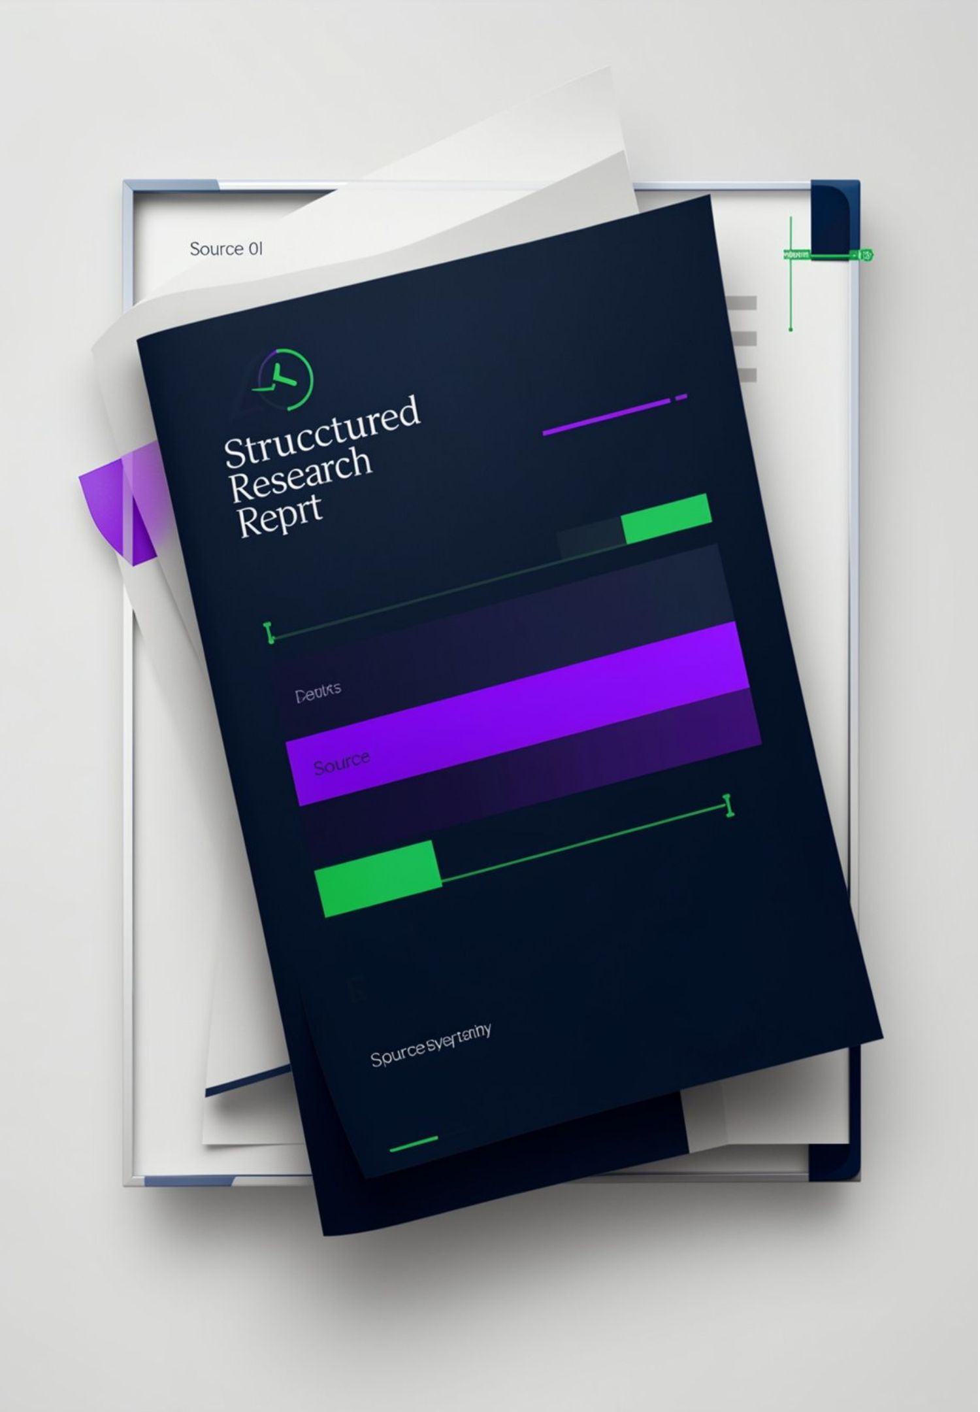
07 — REPORT OUTPUT
The output is a structured report ready to review and share
Report sections
Key features
Executive summary · company overview · financial and business analysis · market context · opportunities · risks · sources · final recommendation.
Multi-agent automation · specialized responsibilities · web discovery · evidence-based comparison · PDF generation · email delivery · modular architecture.
Stock Picker Agent
8

Slide 9
FUTURE ENHANCEMENTS
08 — BOUNDARIES AND NEXT STEPS
Verified market APIs
Historical price analysis
Explainable quantitative evaluation
Portfolio risk analysis and backtesting
Interactive dashboards, confidence indicators, and scheduled reports
Useful today, stronger with verification and historical context
CURRENT LIMITS
AI errors
Source dependence
Incomplete or outdated data
Rapidly changing markets
Need for independent verification
Implemented capabilities and proposed future work belong in separate lanes.
Stock Picker Agent
9

Slide 10
09 — CLOSING TAKEAWAY
Stock Picker Agent turns research into an automated workflow
Company discovery → financial research → candidate comparison → research recommendation → PDF report → email delivery
1
2
3
4
5
Practical Generative AI implementation
CrewAI multi-agent orchestration
Groq-powered LLM inference
Automated web research and report generation
A foundation for a broader financial research platform
Stock Picker Agent — Turning Financial Research into an Automated, Intelligent Workflow.
Thank You

